Slide 1
Great Outdoors Group-B
By:
Abhishek Pratap Singh
Prafull Sharma
C Akhil Chowdary
Arshpreet
Ayush Agarwal
Sravani

Slide 2
Epic and User Stories
Epic: Salesman should upload offline order in website.
User Story:
Salesman will upload order details like product id, quantity price etc.
Salesman can update or remove offline order details.
Salesman can get details of all order using retailer id.
Epic: Salesman should upload offline returns in website.
User Story:
Salesman can upload return details by adding reason for returns,
Salesman can get details of all return using order id.

Slide 3
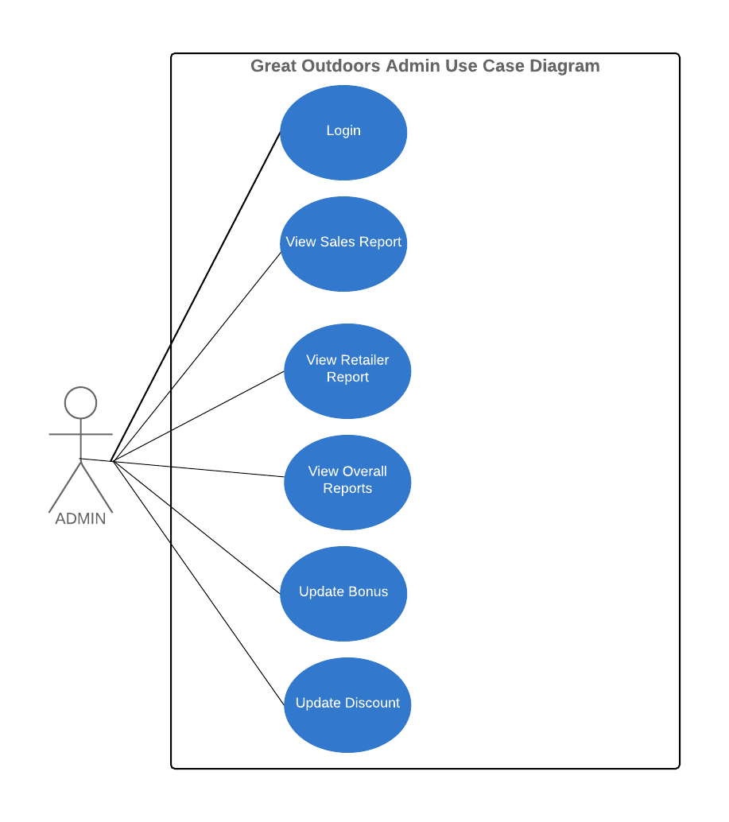

Slide 4
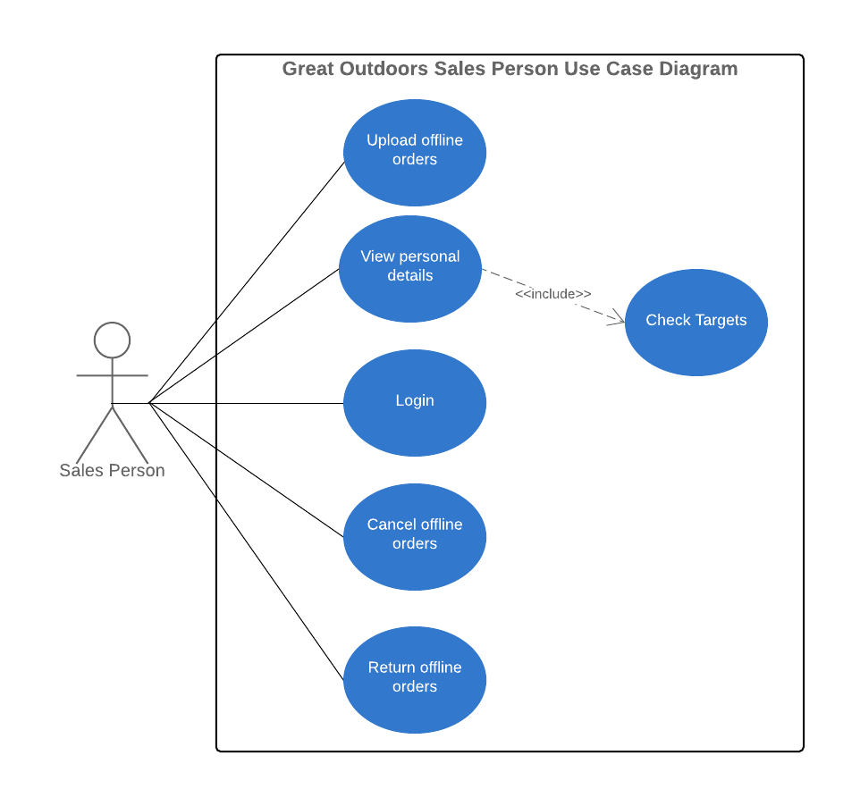

Slide 5
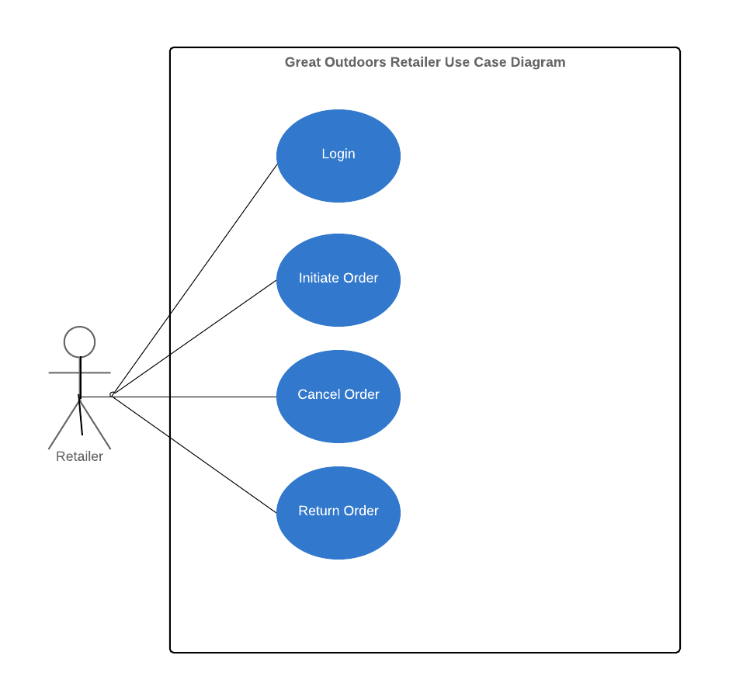

Slide 6
SEQUENCE DIAGRAM

Slide 7
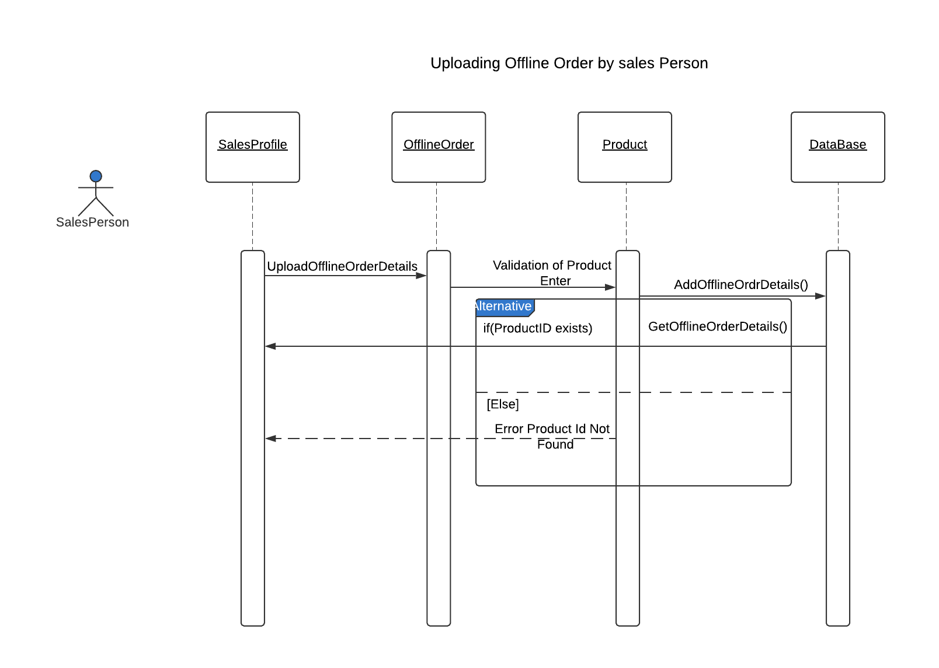

Slide 8
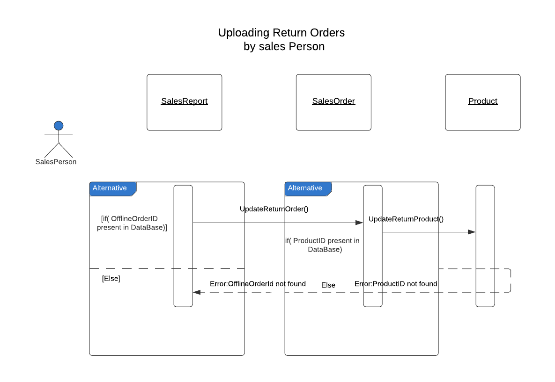

Slide 9
CLASS DIAGRAMS

Slide 10
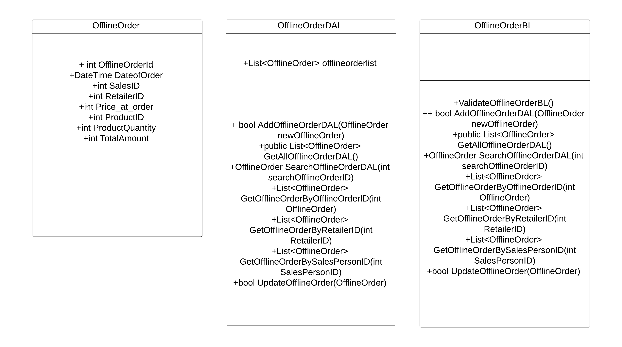
OFFLINE ORDER CLASS DIAGRAM

Slide 11
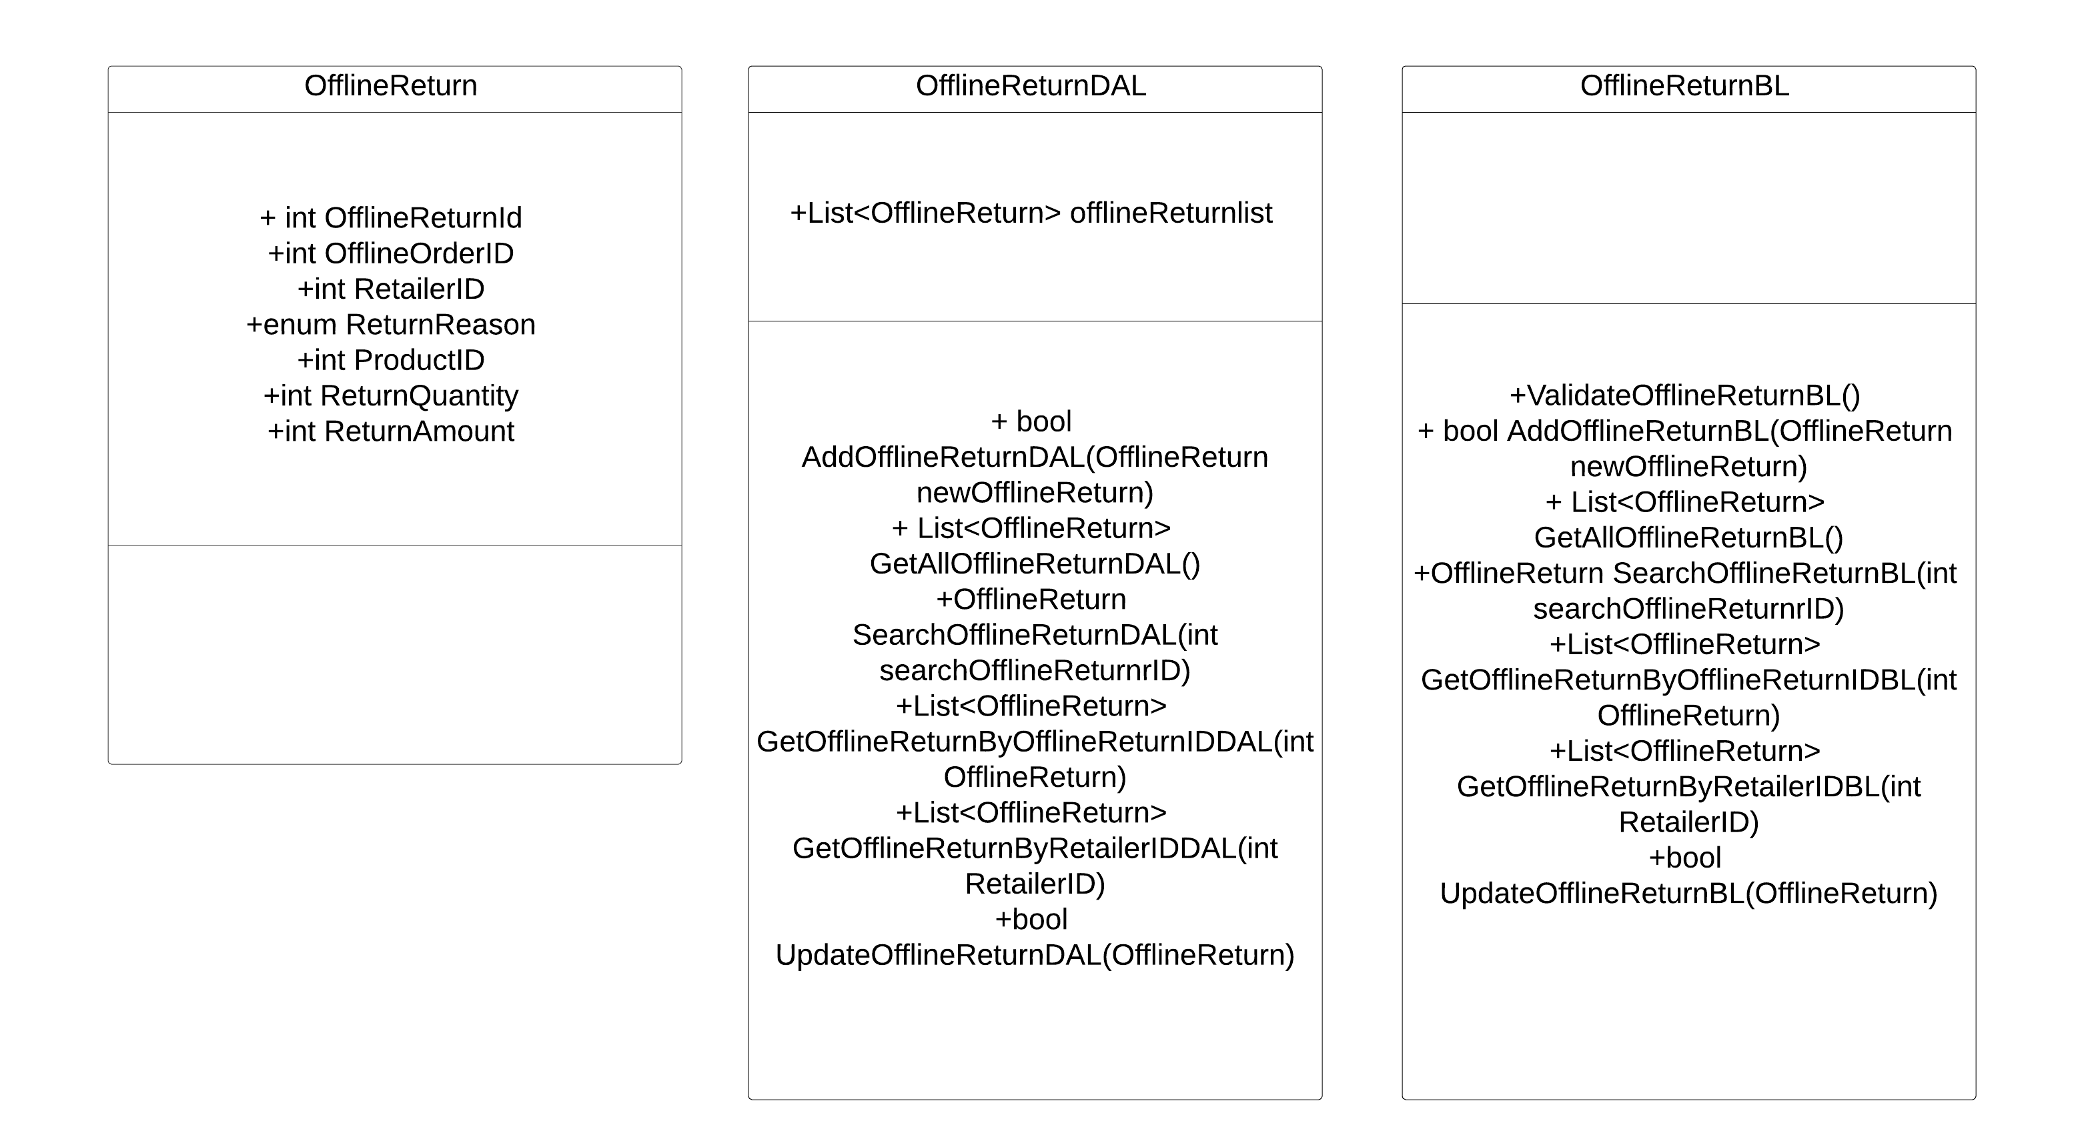
OFFLINE RETURN CLASS DIAGRAM

Slide 12
THANK YOU

